Slide 1

Project Contributors
Vangelis Diaskoufis
George Birmpakos
Kostas Kalentzis
Vasilis Katsikas
Notes:
Καλησπέρα σας, είμαστε οι ....... , και ->

Slide 2
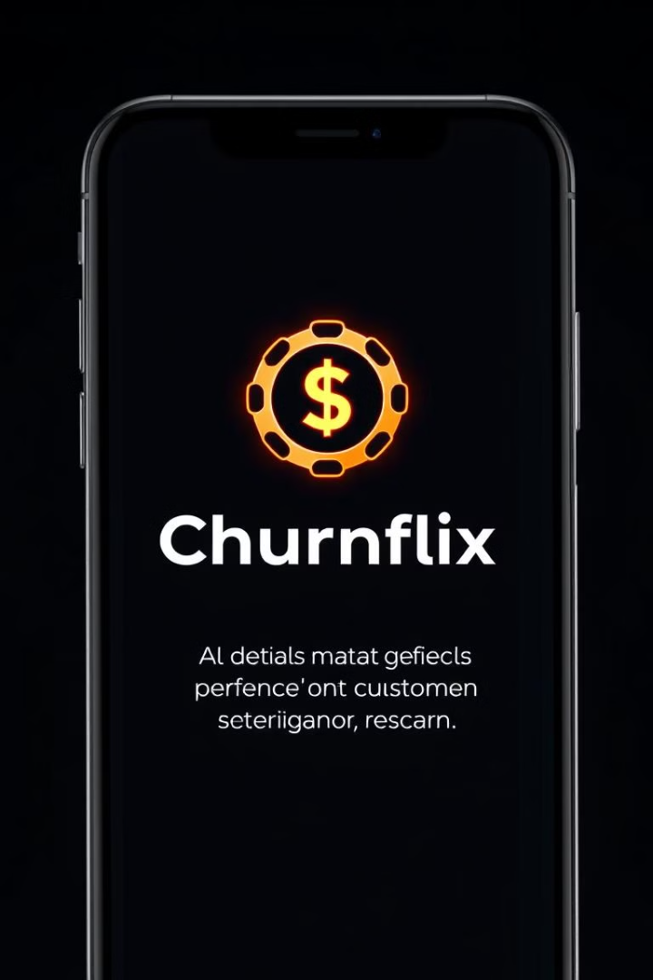
Churnflix: Bank Churn Prediction App
This presentation will introduce Churnflix, a machine learning powered application designed to predict and mitigate customer churn for financial institutions.
Notes:
Δημιουργήσαμε μία εφαρμογή, την Churnflix, προκειμένου να δοθεί η δυνατότητα στις τράπεζες να προβλέψουν ποιοι πελάτες θα αποχωρήσουν.

Slide 3
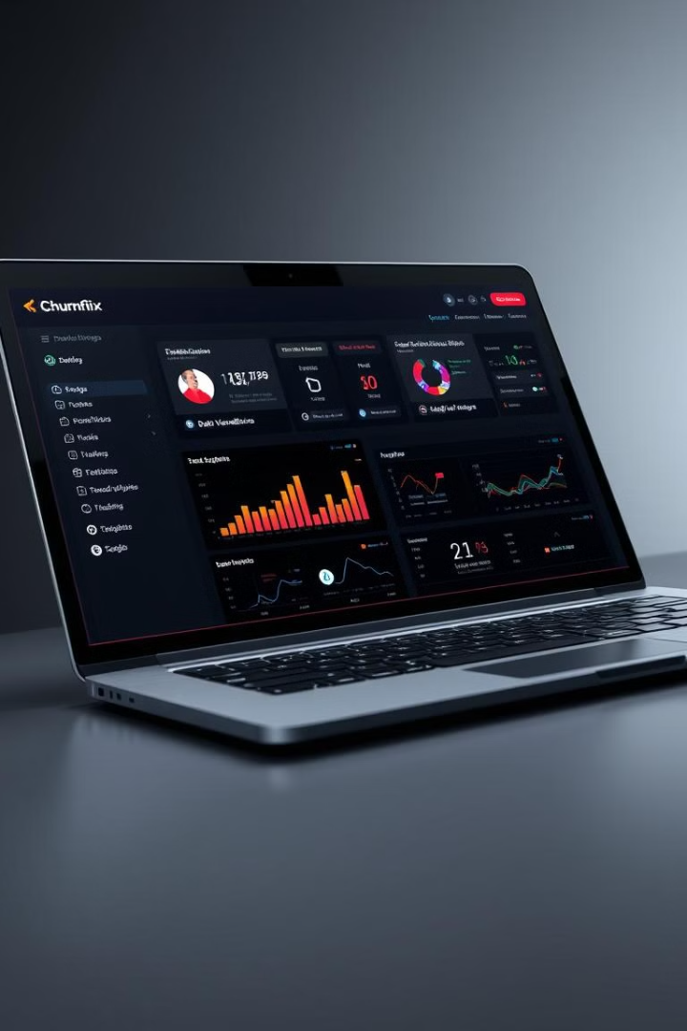




Key Features
Modern UI
Predictive Analytics
Custom Reports
Netflix-inspired dark-themed interface for user-friendliness
Dynamic reports for analyzing business insights
AI-driven customer churn prediction using XGBoost
FastAPI Backend
Efficient backend for handling ML predictions
Notes:
Η βασική δομή της εφαρμογής αποτελείται από
Front end με υλοποίηση react framework,
2. Back End Microservice με FAST API
ML algorithm XGBoost

Slide 4




How It Works
Step 1: User Input
The user provides key financial details (e.g., Credit Score, Age, Balance)
Step 2: Model Prediction
The backend processes the input using a trained XGBoost model
Step 3: Churn Forecast
The system predicts whether the customer is likely to churn
Step 4: Feature Importance
XGBoost explains which features had the most impact
Notes:
Η ροή της εφαρμογής έχει όπως παρακάτω :
Ο χρήστης εισάγει δεδομένα όπως πιστοληπτική ικανότητα, ηλικία, υπόλοιπο λογαριασμού.
Το μοντέλο XGBoost κάνει την πρόβλεψη για το αν ο πελάτης θα φύγει ή θα παραμείνει.
Η εφαρμογή εμφανίζει τα αποτελέσματα, δείχνοντας ποιοι παράγοντες επηρεάζουν την απόφαση.

Slide 5
Business Impact
Reduce Customer Loss
Increase Retention
Explainable AI
Identify at-risk customers early to minimize churn
Enable personalized marketing campaigns & offers
Use XGBoost feature importance to understand churn drivers
Notes:
Ως εκ τούτου, η τράπεζα μπορεί να προσαρμόσει τις υπηρεσίες της, προσφέροντας καλύτερη εξυπηρέτηση σε πελάτες που κινδυνεύουν να φύγουν.

Slide 6
Customer Distribution and Churn Analysis
Customer Retention
Churn Rate
Key Insights
The majority of customers (80%) remained with the bank.
Only 20% of customers (2,000 individuals) churned.
This suggests a high level of customer satisfaction among those who stayed.

Slide 7
Machine Learning Approach
Gender Distribution: 54% male, 46% female. This indicates a relatively balanced customer base.
Age Groups: Customers aged 35-55 have the highest churn rate. This highlights a potential area for targeted retention efforts.
Product Holdings: Customers with fewer products exhibit higher churn probabilities. This suggests a need to incentivize product diversification.

Slide 8
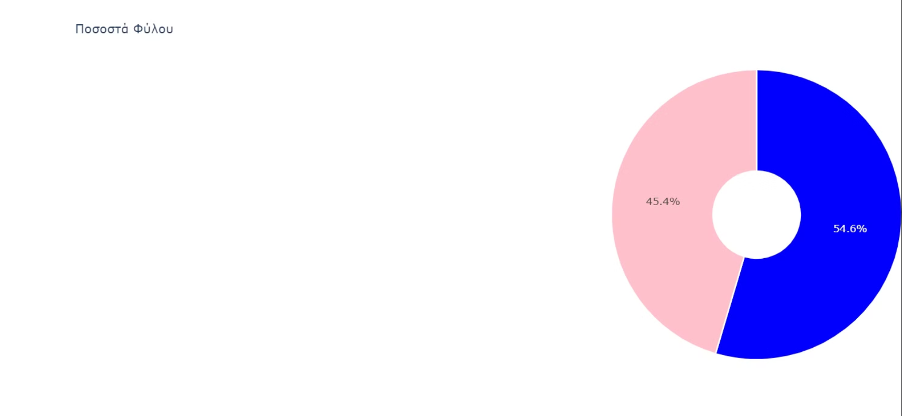

Slide 9
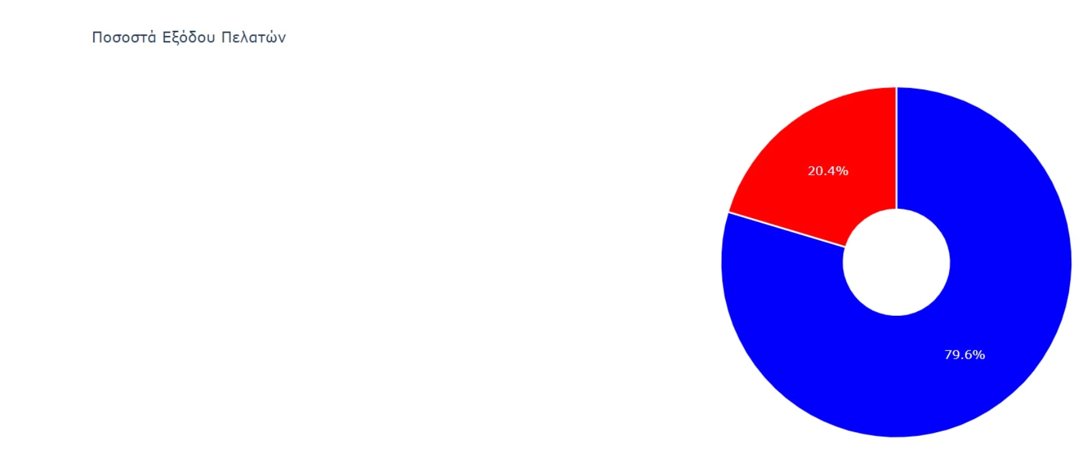

Slide 10
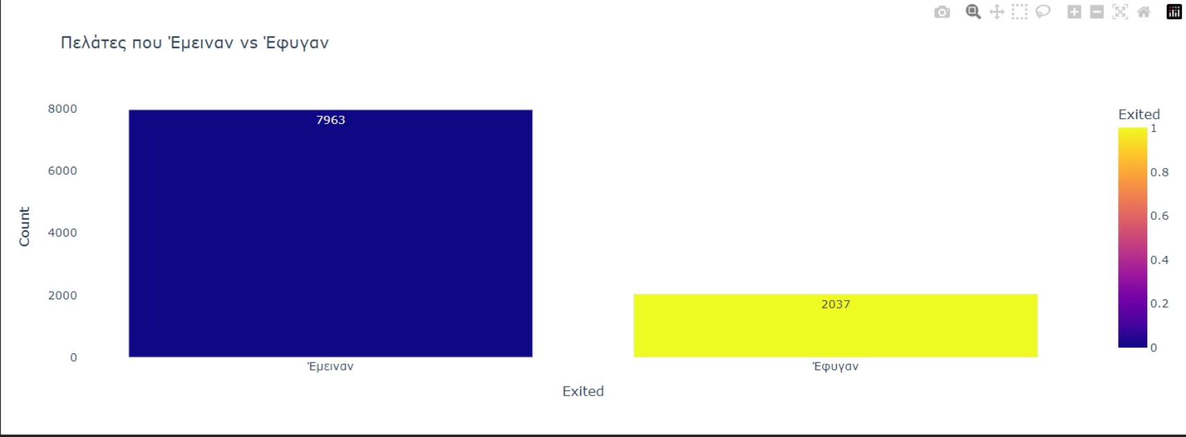

Slide 11
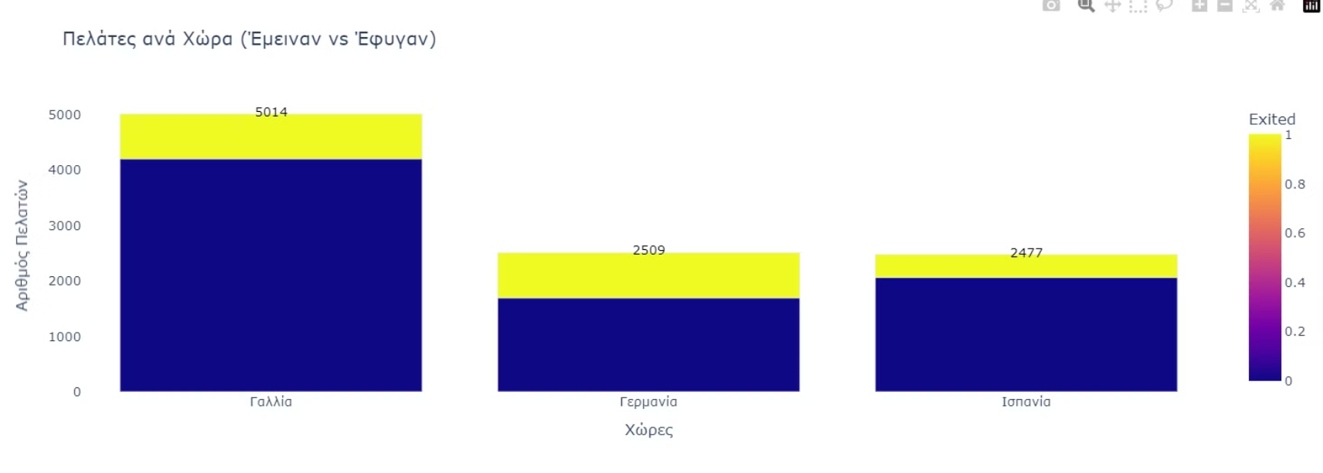

Slide 12
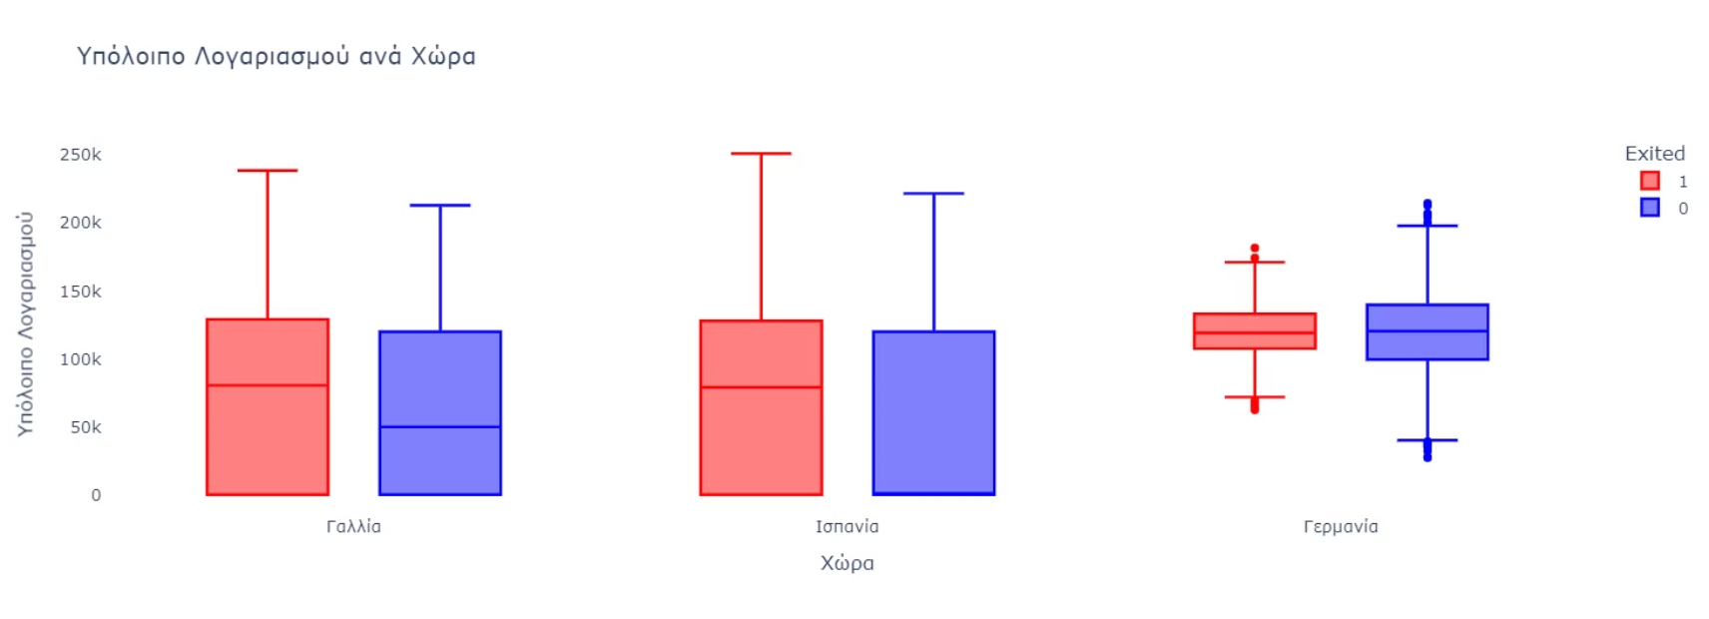

Slide 13
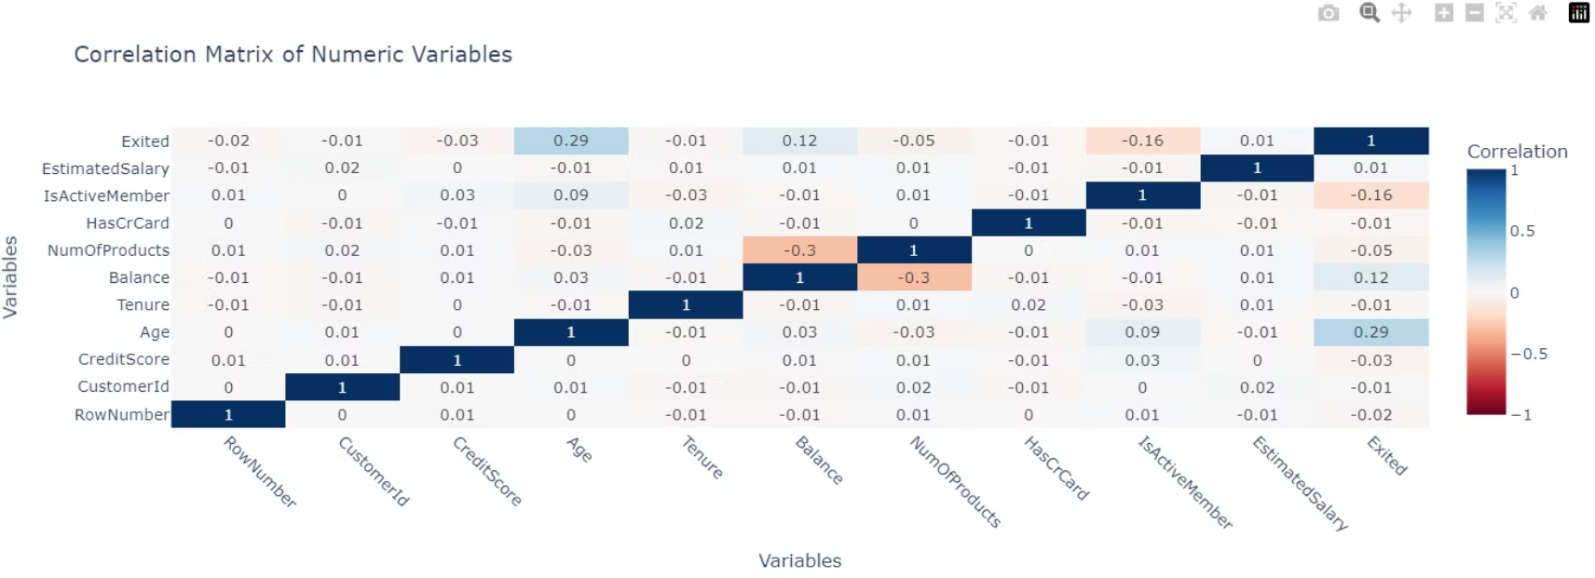

Slide 14
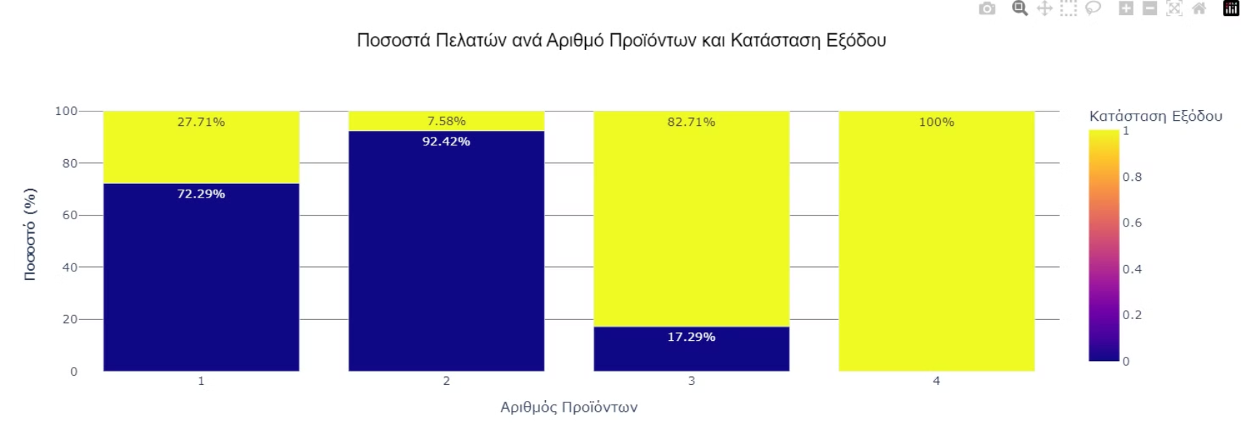

Slide 15

Machine Learning Approach
1
Data preprocessing: Removed outliers using IsolationForest, scaled numeric features with StandardScaler, encoded categorical data via one-hot encoding, and selected the top 10 important features using SelectKBest.
2
Model training: Used an XGBoost Classifier, optimized via Grid Search, applied SMOTE to handle class imbalance, and tuned hyperparameters for best performance.
3
Feature explanation: Used XGBoost's built-in feature importance, permutation feature importance, and partial dependence plots (PDP) to visualize the influence of individual features on predictions.

Slide 16
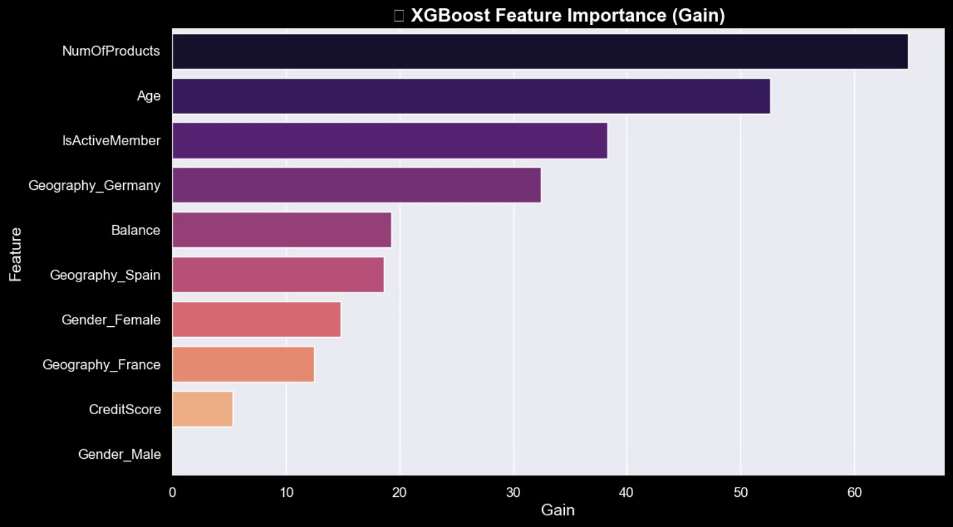

Slide 17


Final Deliverables
Functional Web App
Live predictions for churn probability
Trained XGBoost Model
High accuracy for churn prediction
Data-Driven Insights
Actionable intelligence for financial institutions
Feature Explanations
Churn probability and key feature explanations

